Slide 1

Developing resilience
Understanding Stress, Mental Health & Coping Skills
Joanna Kesicka
Student Counselling Service
Trinity Student Counselling Service

Slide 2






Session Objectives
Mental Health
Coping Skills
Build Resilience
Trinity Supports
Gain clarity on what psychological wellness truly encompasses beyond the absence of illness.
Discover practical tools for grounding, mindfulness, and emotion regulation in daily life.
Learn how to widen your window of tolerance and soften critical inner narratives.
Explore free, confidential student counseling and support networks available to you.

Slide 3



What is Mental Health?
Encompasses our overall capacity to navigate life:
•
Work: A sense of agency and capacity to feel that what you do has meaning.
•
Love: The capacity to build authentic, intimate relationships with others.
•
Play: Enjoying life, singing, dancing, and being an active participant.
•
Distress Tolerance: Tolerating emotional pain rather than constantly chasing contentment.
"Psychological wellness is not just the absence of mental health issues." — Nancy McWilliams

Slide 4




Why Difficulties Arise
Unmet Needs & Demands
Isolation & Critical Narrative
When basic emotional needs (safety, acceptance, love) remain unfulfilled, or when environmental demands heavily outweigh available coping resources.
Feeling powerless, under threat, or overwhelmed to the point of feeling alone in your experience—often getting stuck in severe self-critical thoughts.

Slide 5
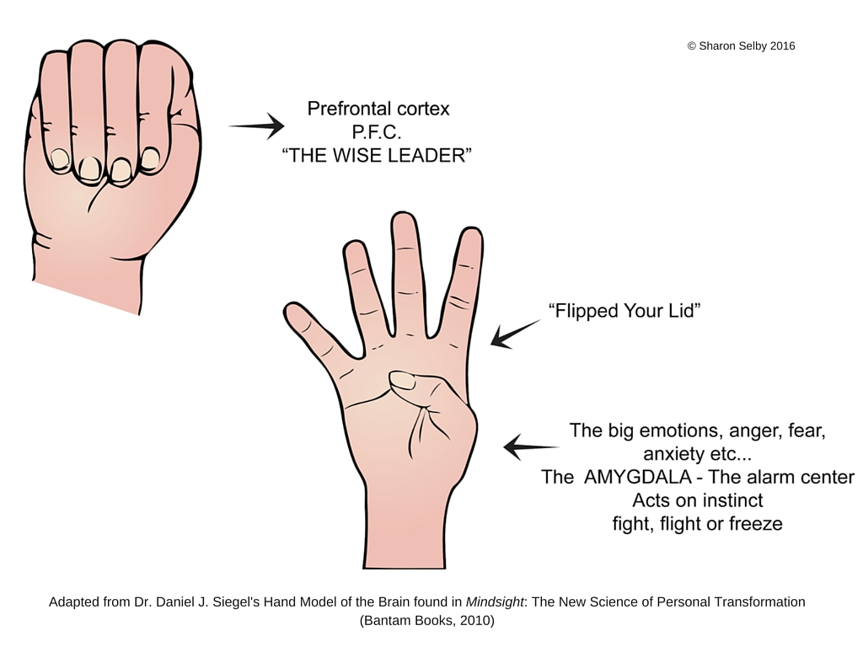
Brain – Hand Metaphor (Dr. Dan Seigel)

Slide 6
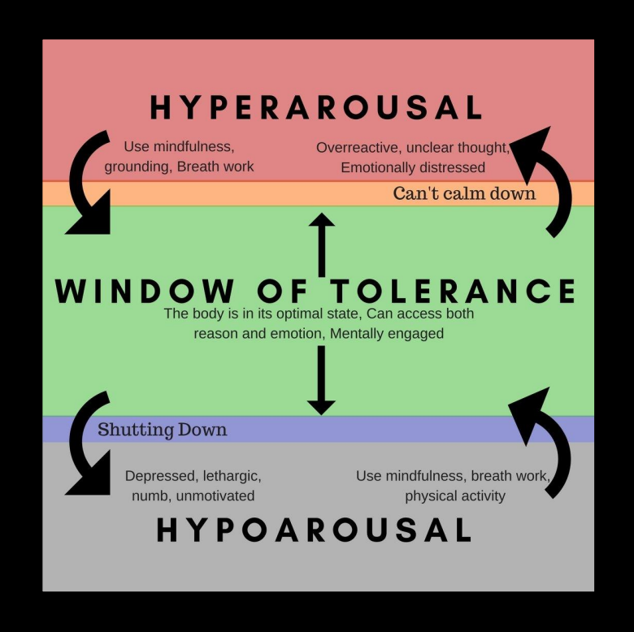

Stress & The Window of Tolerance

Slide 7
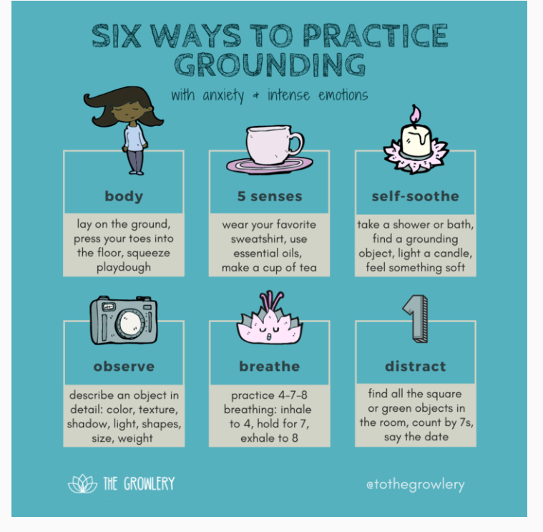
Widening the Window

Slide 8

Accepting Difficult Feelings
Emotional pain is like physical pain – it can act as a messaging system telling us what we need.
Our challenge when we have a strong emotional response is stop and name it as accurately as we can.
Make space for our unpleasant thoughts and feelings without trying to get rid of them or deny them. Without the struggle, our emotions unfreeze.
Trust that our emotions are telling us something important.

Slide 9
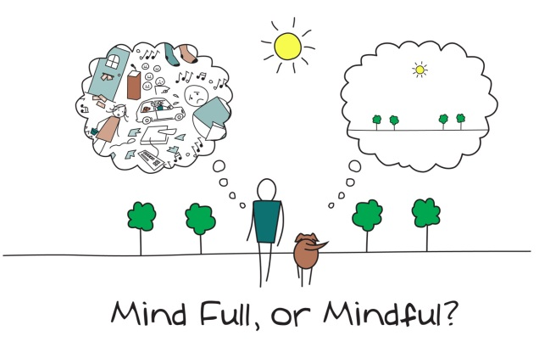
Mindfulness
What is it?
Moment-to-moment, non-judgmental awareness
Paying attention in a specific way – in the Present
Non-reactively, non-judgementally, and open-heartedly
The capacity to know what is happening, as it is happening
(we already have it!)
What does it involve?
Training the mind to concentrate
Becoming more aware in our everyday lives
Practice anywhere, any time

Slide 10
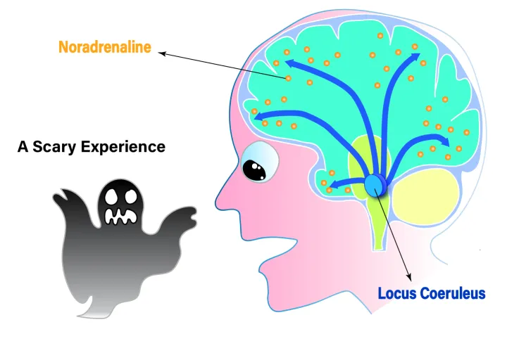
Neuroscience of Survival Brain Training
Source:
Prof. Ian Robertson, Trinity College Dublin

Slide 11
Widening the Window
Sleep
Nutrition
Breaks
Exercise
Mindful Practice
Connect with others

Slide 12

Stress & Thoughts
Some thinking traps can intensify stress: catastrophizing/emotional reasoning
Take them to be reality (flooded)
We can become fused with our thoughts
Struggle to take in other information
Hands as Thoughts Metaphor

Slide 13
Thought Diffusion
Step Back from the situation, in your mind. Don’t act immediately or automatically. Pause.
Take a Breath.
Observe. What am I thinking and feeling? Are the thoughts accurate or inaccurate? Helpful or unhelpful?
Pull Back - Put in some Perspective.

Slide 14
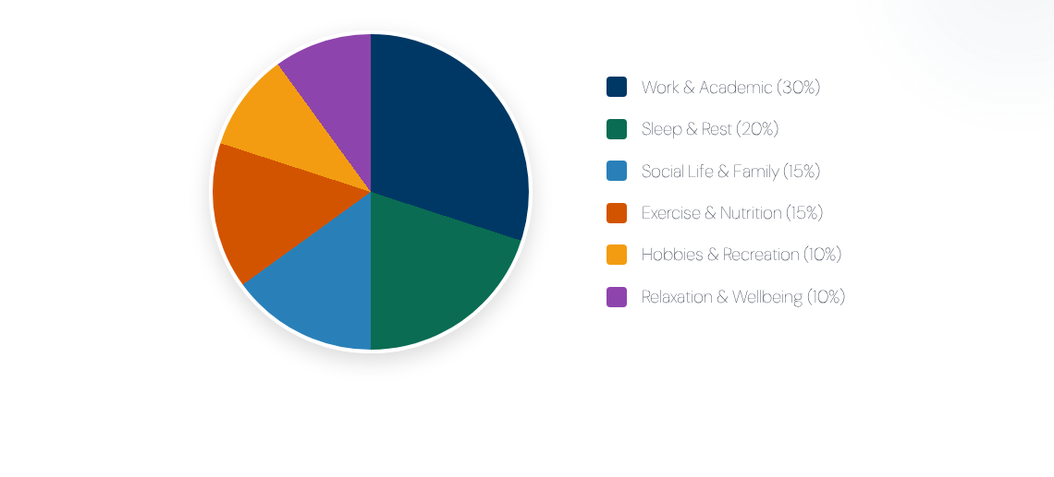
The Life Balance Pie
A balanced lifestyle structure is essential for wellbeing. Refuel across all areas rather than letting academic work consume your entire pie.

Slide 15





Assertive Communication Framework
1. Say What You See
2. Say What You Feel
3. Say What You Need
State objective facts clearly.
"You're asking me to take on an extra project next semester."
Express direct personal impact.
"I am worried this might impact my core deliverables."
Provide a constructive takeaway.
"Can we review duties to ensure I can fit everything in?"

Slide 16
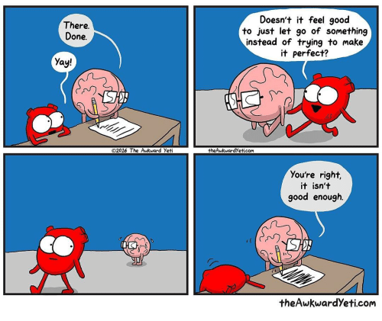

Slide 17

The “Inner Critic”
How do I feel when I speak to myself this way?
What does it cost me?
What do I fear would happen if I let it go?
Notes:
When our thinking brains are not kind to us - Think of your inner monologue when you have messed up, when you're angry with yourself, when you're giving yourself a really hard time.
Imagine how they look at you. Imagine the tone they use. What do they think of you?
(Draw the comparison with bullying/abuse. )
Arguing back not always helpful – often we agree with them. It's not about the details of what they are saying, it is about how they are treating you.

Slide 18
The “Inner Critic”
What does it sound like when you beat yourself up?
Imagine that self-critic stepping outside of you – personify it (mentalizing = down-regulating)

Slide 19
Softening the Inner Critic
Step 1: Notice when you are being self-critical. Whenever you’re feeling bad about something, think about what you’ve just said to yourself. Try to be as accurate as possible, noting your inner speech verbatim.
Step 2: Make an active effort to soften the self-critical voice with compassion rather than self-judgment
Step 3: Reframe the observations made by your inner critic in a friendly, positive way.

Slide 20
Softening the Inner Critic
On a sheet of paper and answer the following questions:
How do you respond to a close friend who feels bad about him or herself or is really struggling in some way (when you are at your best)?
How do you typically respond to yourself in when you feel bad?
What's the difference? Why? What factors or fears lead you to treat yourself and others so differently?
Write down how you think things might change if you responded to yourself in the same way you typically respond to a close friend when you’re suffering.
Source: Dr. Kristin Neff, Self-compassion.org

Slide 21
Postgraduate & Student Insights
Befriend Imposter Syndrome: Accept perfectionism as a mindset to manage, not a standard to maintain.
Reframe Setbacks: Failures are natural stepping stones in learning. Ask yourself: "What is the worst that can happen?"
Normalize 'Not Being OK': Conduct regular internal check-ins. The earlier you recognize distress, the easier it is to address.
Practice Daily Gratitude: Focus on and savor small achievements each day using simple tools like the 10-finger gratitude exercise.

Slide 22


Slide 23

Trinity College Support Services
Support Service | Offerings | Contact / Info
Student Counselling | Free, confidential, brief individual counseling | student-counselling@tcd.ie
Learning Support | Academic skills, time management & planning | student.learning@tcd.ie
Health & Disability | Medical health care and disability support services | College Health & Disability Service
Out of Hours / Crisis | 24/7 Helpline, Samaritans, | Tel: 1800 793 793 / 116 123

Slide 24

Out of Hours Support
Crisis Text Line:
Niteline
www.niteline.ie
Tel: 1800 793 793
Notes:
Chuck

Slide 25

Other Trinity Supports
College Health Service
Trinity Disability Service
Chaplaincy: 01 896 1260/1901
Trinity Sport
Your Academic Tutor
Notes:
Chuck

Slide 26


Slide 27
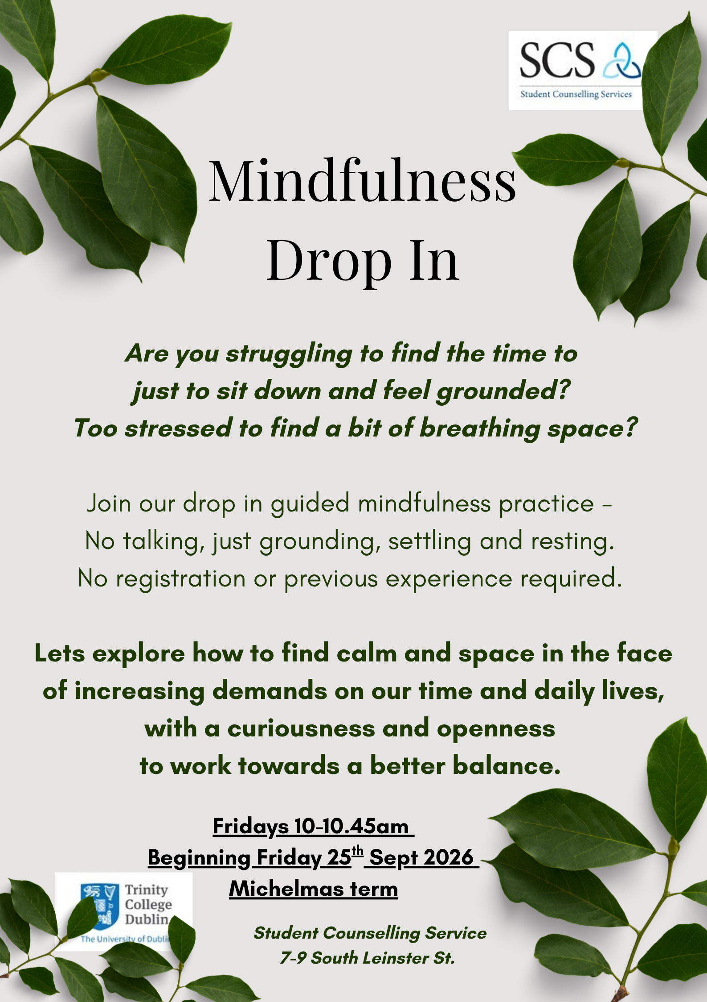

Slide 28
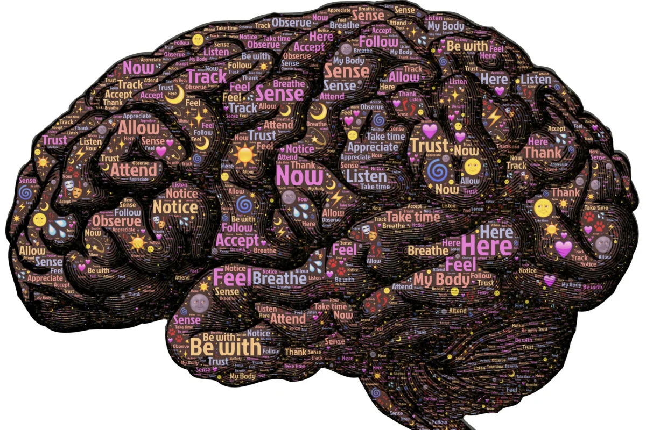
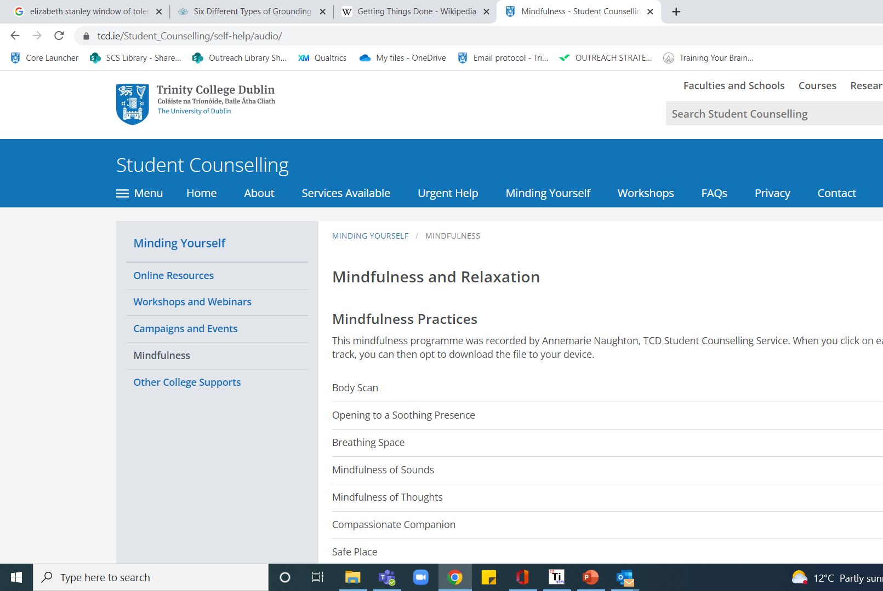
Free Brain Training Resources
https://www.tcd.ie/Student_Counselling/self-help/audio/
Notes:
Chuck

Slide 29
"What is one way you would like to commit to looking after yourself today?"
(Write it down. )

Slide 30

Thank You
"
Trinity Student Counselling Service
Free, Confidential (brief) Counselling
To inquire, email: student-counselling@tcd.ie

